Slide 1
Intermediate SQL
— Chapter 4
2021年9月
叶文
yewen@bupt.edu.cn
School of Computer Science (National Pilot Software Engineering School)

Slide 2
Outline
Join Expressions
Views
Transactions
Integrity Constraints
SQL Data Types and Schemas
Authorization
ioin-based multi-table select
Virtual table query
concepts, definition by SQL statements
foreign key/referential Integrity, check, assertion
grant,revoke

Slide 3
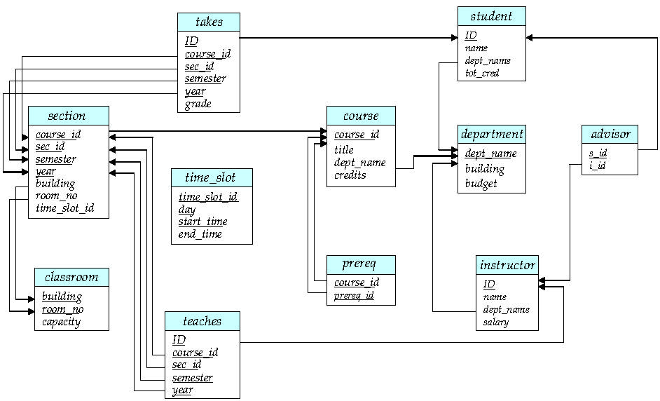
return

Slide 4
4.5 SQL Data Types and Schemas
In addition to the basic data types, e.g. char(n), varchar(n), int, smallint, numeric(p, d), real, double precision, float(n), the other built-in data types include
date: Dates, containing a (4 digit) year, month and date
e.g. date ‘2017-7-27
time: Time of day, in hours, minutes and seconds
e.g. time ‘09:00:30.75
timestamp: date plus time of day
e.g. timestamp ‘2017-7-27 09:00:30.75’
interval: period of time
if x and y are of type date, then x-y is an interval whose value is the number of days from date x to date y
e.g. interval ‘1’ day=‘2017-7-27’ – ‘2017-7-28’

Slide 5
Built-in Data Types in SQL (cont.)
cast e as t
convert a character string (or string valued expression) e to the type t , e.g. date/time/timestamp
e.g. cast ‘2017-07-20’ as date
e.g. cast ‘09:00:30.75’ as time
For a day or time value d, its individual fields can be extracted
e.g. extract (year from 2017-07-20) =2017
e.g. extract (timezone_hour from 2017-7-27 09:00:30.75) =09

Slide 6
Large-Object Types
Large objects (photos, videos, CAD files, etc.) are stored as a large object
blob: binary large object
the object is a large collection of uninterpreted binary data, whose interpretation is left to an application outside of the database system
clob: character large object
the object is a large collection of character data
When a query returns a large object, a pointer is returned rather than the large object itself !

Slide 7
Large-Object Types (cont.)
E.g.
book_view clob(10KB)
image blob(10MB)
movie blob(2GB)
Now, Oracle, DB2, and SQL Server also support the XML data type integrated in relational schemas, i.e. the attributes of XML data type in relational tables
e.g. Create table book
book_id int primary key
book_view clob(10KB)
image blob(10MB)
movie blob(2GB)
catalog XML

Slide 8
User-defined Types
The create type clause can be used to define new user-defined types
e.g. create type Dollars as numeric (12,2) final
create table department (dept_name varchar (20), building varchar (15), budget Dollars);
cast, i.e. convert, values of one type to another domain
cast (department.budgt to numeric(12.2))
, then the expression
(department.budgt + 20)
can be evaluated

Slide 9
Domains
create domain construct in SQL-92 creates user-defined domain types
create domain person_name char(20) not null
Types and domains are similar. Domains can have constraints, such as not null, specified on them.
create domain degree_level varchar(10) constraint degree_level_test check (value in (’Bachelors’, ’Masters’, ’Doctorate’));

Slide 10
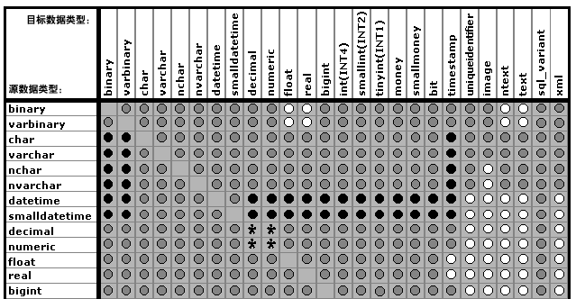
SQL Server 类型转换
return

Slide 11
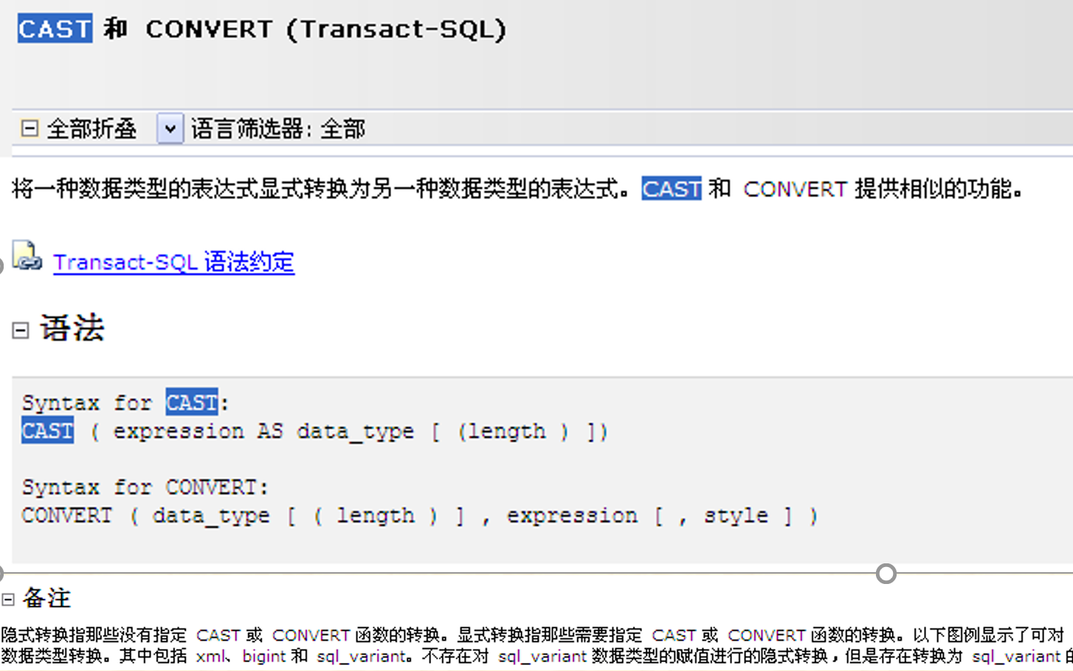
CAST/CONVERT for Data Type Transition

Slide 12
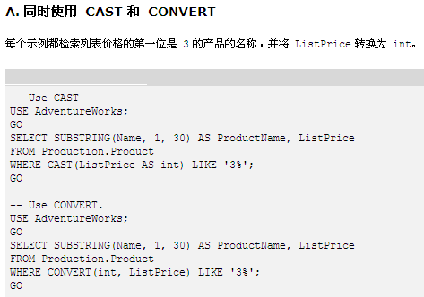
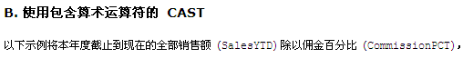
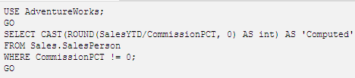
varchar, e.g. 350.00
return

Slide 13
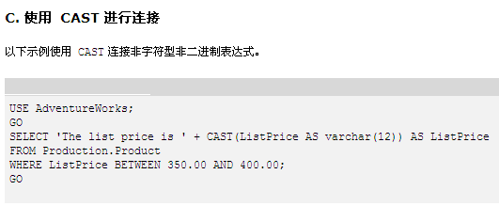
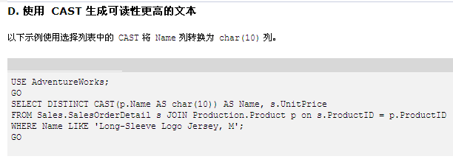
float
varchar

Slide 14
Default Values
create table student (ID varchar (5), name varchar (20) not null, dept_name varchar (20), tot_cred numeric (3,0) default 0, primary key (ID))
insert into student(ID, name, dept_name)
values (‘12789’, ‘Newman’, ‘Comp.Sci’)
只有3列

Slide 15
Index Creation
create table student (ID varchar (5), name varchar (20) not null, dept_name varchar (20), tot_cred numeric (3,0) default 0, primary key (ID))
create index studentID_index on student(ID)
Indices are data structures used to speed up access to records with specified values for index attributes
e.g. select * from student where ID = ‘12345’
can be executed by using the index to find the required record, without looking at all records of student
More on indices in Chapter 11

Slide 16
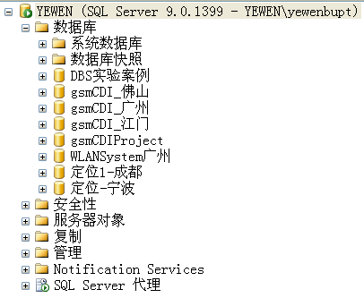
Schemas, Catalogs, and Environments
How to name the relations in DB, or how to specify the names of the relations in DB
The three-level hierarchy for naming relations
catalogs（全文目录）, each of which can contain schemas;
The catalog is also called database
schemas（架构）, in which the relations and views are stored
the Schema object represents an ownership context for a Microsoft SQL Server database object.
relations and views
e.g. a three-part name for the relation
catalog5.bank_schema.account
SQL environments, including
connection, catalog, schema, user identifier

Slide 17
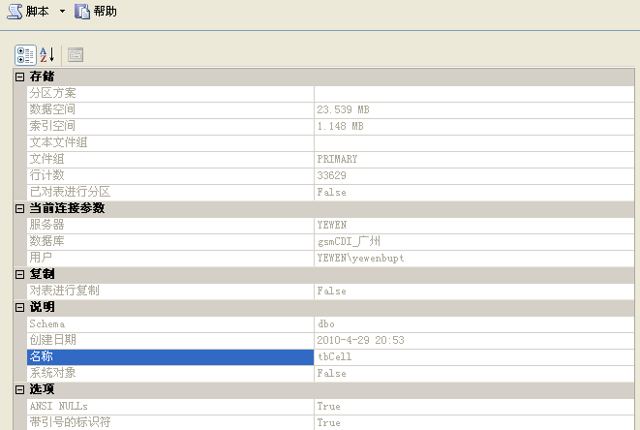
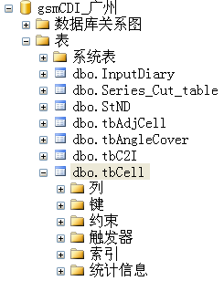
Schemas, Catalogs, and Environments
右键属性

Slide 18
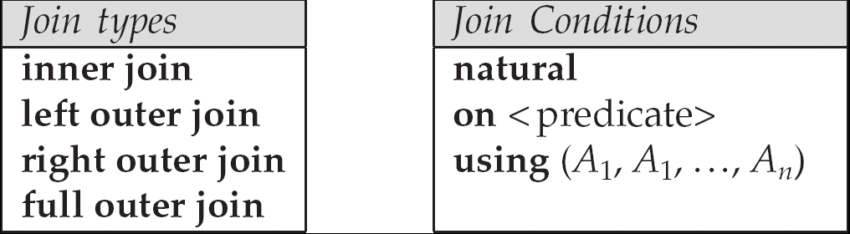
4.1 Joined Expressions
Join operations take two relations and return as a result another relation.
A join operation is a Cartesian product which requires that tuples in the two relations match (under some condition). It also specifies the attributes that are present in the result of the join
The join operations are typically used as subquery expressions in the from clause
Join condition – defines which tuples in the two relations match, and what attributes are present in the result of the join.
Join type – defines how tuples in each relation that do not match any tuple in the other relation (based on the join condition) are treated.

Slide 19
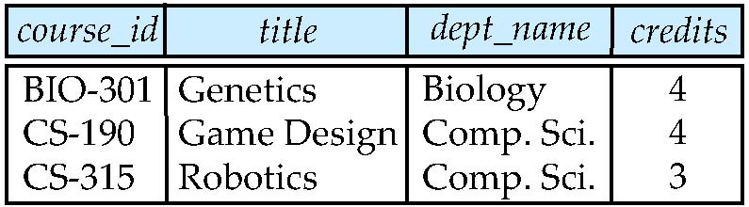
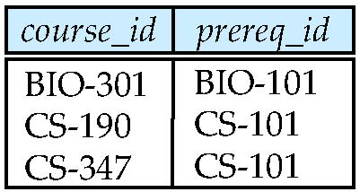
Natural Join operations
For the following two relations
course
prereq
select * /*SQL Server似乎不支持natural join
from course natural join prereq
select *
from course join prereq
on course.course_id=prereq. course_id
Observe that, course natural join prereq on course_id
prereq information is missing for CS-315 and
course information is missing for CS-437

Slide 20
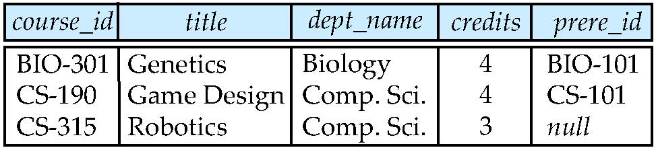
Outer Join
An extension of the join operation that avoids loss of information.
Computes the join and then adds tuples form one relation that does not match tuples in the other relation to the result of the join.
Uses null values.
Left Outer Join
course natural left outer join prereq
select *
from course natural left outer join prereq

Slide 21
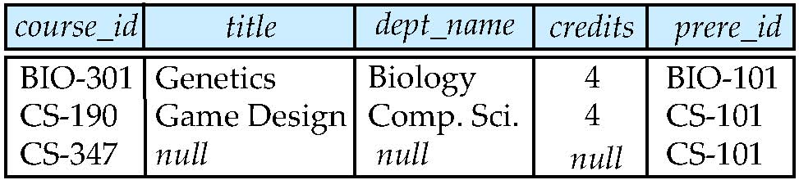
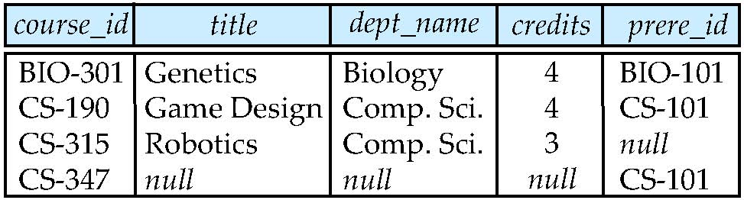
Outer Join
Right Outer Join
course natural right outer join prereq
select *
from course natural right outer join prereq
Full Outer Join
select *
from course natural full outer join prereq

Slide 22
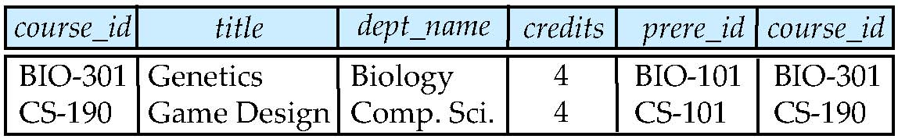
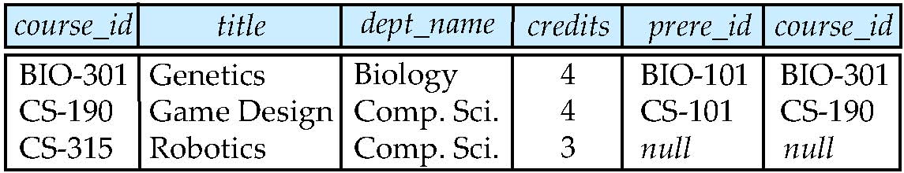
Joined Relations – Examples
course inner join prereq on course.course_id = prereq.course_id
What is the difference between the inner join mentioned above, and a natural join?
course left outer join prereq on course.course_id = prereq.course_id

Slide 23
Joined Relations – Examples
course natural right outer join prereq
course full outer join prereq using (course_id)

Slide 24
4.2 Views
In some cases, it is not desirable for all users to see the entire logical model (that is, all the actual relations stored in the database.)
Consider a person who needs to know an instructors name and department, but not the salary. This person should see a relation described, in SQL, by select ID, name, dept_name from instructor
A view provides a mechanism to hide certain data from the view of certain users.
Any relation that is not of the conceptual model but is made visible to a user as a “virtual relation” is called a view.

Slide 25
Views Definition
Views = projection on one or more relations
view5
view4
view1
view2
view3
….
….
….
….
table r1
table r2

Slide 26
Views as Virtual Table
The view is also known as the virtual relation/table
only the definition of the view itself is stored in DBS, the tuples of the view is stored in the relations on which the view is defined
evaluation of a view is reduced to evaluation of the relation-algebra expression that define the view
Note:
differences between the with clause and the create view clause
Materialized views (实体化/物化视图)
both the definition and data of the views are stored in DBS

Slide 27
View Definition in SQL
A view is defined using the create view statement which has the form
create view v as <query expression >
where <query expression> is any legal SQL expression. The view name is represented by v.
Once a view is defined, the view name can be used to refer to the virtual relation that the view generates.
View definition is not the same as creating a new relation by evaluating the query expression
Rather, a view definition causes the saving of an expression; the expression is substituted into queries using the view

Slide 28
Example Views
A view of instructors without their salary create view faculty as select ID, name, dept_name from instructor
Find all instructors in the Biology department select name from faculty where dept_name = ‘Biology’
Create a view of department salary totals create view departments_total_salary(dept_name, total_salary) as select dept_name, sum (salary) from instructor group by dept_name;

Slide 29
Views Defined Using Other Views
create view physics_fall_2009 as select course.course_id, sec_id, building, room_number from course, section where course.course_id = section.course_id and course.dept_name = ’Physics’ and section.semester = ’Fall’ and section.year = ’2009’;
create view physics_fall_2009_watson as select course_id, room_number from physics_fall_2009 where building= ’Watson’;

Slide 30
Views Defined Using Other Views
One view may be used in the expression defining another view
A view relation v₁ is said to depend directly on a view relation v₂ if v₂ is used in the expression defining v₁
A view relation v₁ is said to depend on view relation v₂ if either v₁ depends directly to v₂ or there is a path of dependencies from v₁ to v₂
A view relation v is said to be recursive if it depends on itself.

Slide 31
View Expansion
Expand use of a view in a query/another view
create view physics_fall_2009_watson as
(select course_id, room_number
from (select course.course_id, building, room_number
from course, section
where course.course_id = section.course_id
and course.dept_name = ’Physics’
and section.semester = ’Fall’
and section.year = ’2009’)
where building= ’Watson’;

Slide 32
View Expansion
A way to define the meaning of views defined in terms of other views.
Let view v₁ be defined by an expression e₁ that may itself contain uses of view relations.
View expansion of an expression repeats the following replacement step:
repeat Find any view relation v_{i} in e₁ Replace the view relation v_{i} by the expression defining v_{i} until no more view relations are present in e₁
As long as the view definitions are not recursive, this loop will terminate

Slide 33
Update of a View
Add a new tuple to faculty view which we defined earlier
insert into faculty values (’30765’, ’Green’, ’Music’);
This insertion must be represented by the insertion of the tuple
(’30765’, ’Green’, ’Music’, null)
into the instructor relation

Slide 34
Materialized Views
Materializing a view: create a physical table containing all the tuples in the result of the query defining the view
If relations used in the query are updated, the materialized view result becomes out of date
Need to maintain the view, by updating the view whenever the underlying relations are updated.
1

Slide 35
4.3 Transactions
A transaction consists of a sequence of query and/or update statements and is a “unit” of work
The SQL standard specifies that a transaction begins implicitly when an SQL statement is executed.
The transaction must end with one of the following statements:
Commit work. The updates performed by the transaction become permanent in the database.
Rollback work. All the updates performed by the SQL statements in the transaction are undone.
ACID propertities
Atomicity, Consistency, Isolation, Durability
Atomic transaction
either fully executed or rolled back as if it never occurred
Isolation from concurrent transactions

Slide 36
DECLARE @transfer_name varchar(10) /*事务变量定义*/
SET @transfer_name = ‘I-transfer-from-A-to-B’ /*事务命名*/
BEGIN TRANSACTION @transfer_name /*事务开始*/
USE ACCOUNT /*打开数据库ACCOUNT*/
GO /*将上述批SQL语句提交SQL Server
UPDATE A /* 修改A帐户*/
SET balance = balance – 50
WHERE branch_name= ‘Brooklyn’
UPDATE B /* 修改B帐户*/
SET balance = balance + 50
WHERE branch_name= ‘Brooklyn’
GO
COMMIT TRANSACTION @transfer_name /*事务提交*/
GO

Slide 37
4.4 Integrity Constraints
Integrity constraints guard against accidental damage to the database, by ensuring that authorized changes to the database do not result in a loss of data consistency
Classification of integrity constraints and some examples
refer to Fig.4.0.1
An instructor name can not be null
No two instructors can have the same instructor ID
Every department name in the course relation must have a matching department name in the department relation

Slide 38
 | attribute-level | tuple-level | relation-level
static | data type data format, e.g. YY.MM.DD domain constraints, e.g.1 null value, e.g. not null | constraints among attributes values e.g.2 mapping cardinality constraints | entity integrity e.g.3 referential integrity functional dependency (§8) statistical constraints e.g.6
dynamic | constraints on updating of attribute values or attribute definition e.g.4 | constraints among attributes values e.g.5 | transaction constraint: atomy, consistency, isolation, durability (§ 14, 15, 16)
return

Slide 39
Examples of Integrity Constraints
E.g.1 the salary of manager should not be lower than $1000 in Employee
E.g.2 table T (x, y, z ), z =x+y, z is a derived attributes from x and y.
E.g.3 the student# for table student should not be null
E.g.4 the age of students should only be added
E.g.5 when employee tuples is modified, new.sal > old.sal + 0.5*age
E.g.6 statistical constraints
in table employee , “the salary of manager should be four times more than that of workers”

Slide 40
Constraints on a Single Relation
An SQL relation is defined using the create table command
create table r (A₁ D₁, A₂ D₂, ..., A_{n} D_{n}, (integrity-constraint₁), ..., (integrity-constraint_{k}))
r is the name of the relation
each A_{i} is an attribute name in the schema of relation r
D_{i} is the data type of values in the domain of attribute A_{i}
The allowed integrity constraints include
primary key
not null
unique
check (P ), where P is a predicate
not null
Declare name and budget to be not null
name varchar(20) not null budget numeric(12,2) not null

Slide 41
Constraints on a Single Relation (cont.)
The Unique Constraint is as follows
unique ( A₁, A₂, …, A_{m})
it states that the attributes
A1, A2, … Am form a candidate key
candidate keys are permitted to be null (in contrast to primary keys)
e.g. create table customer (customer-id char(15) customer-name char(15)
customer-city char(30), primary key (customer-id)
unique (customer-name)

Slide 43
Constraints on a Single Relation (cont.)
The check clause is applied to relation declaration as well as to domain declaration
check (P), where P is a predicate
e.g. ensure that semester is one of fall, winter, spring or summer:
create table section (
course_id varchar (8),
sec_id varchar (8),
semester varchar (6),
year numeric (4,0),
building varchar (15),
room_number varchar (7),
time slot id varchar (4),
primary key (course_id, sec_id, semester, year),
check (semester in (’Fall’, ’Winter’, ’Spring’, ’Summer’)) );

Slide 44
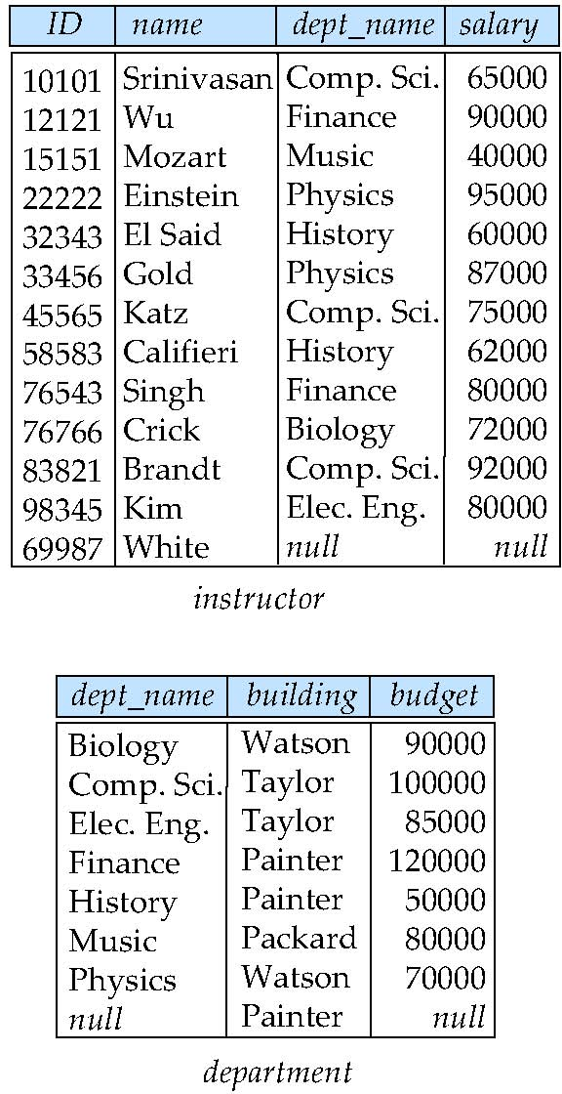
Referential Integrity
Referential Integrity (关联/参照完整性)
ensures that a value that appears in one relation for a given set of attributes also appears for a certain set of attributes in another relation
E.g. If “Biology” is a department name appearing in one of the tuples in the instructor relation, then there exists a tuple in the department relation for “Biology”
Math
where is‘Math’?

Slide 45
Referential Integrity (cont.)
Definition of referential integrity/subset dependecies
Let r₁(R₁) and r₂(R₂) be relations with primary keys K₁ and K₂ respectively, refer to Fig. 4.0.2
e.g. r₁: department(dept_name, building, budgt)
r₂: course(course_id, title, dept_name, credits),
the subset α of R₂ (e.g. dept_name) is a foreign key (from r₂, e.g. course) referencing K₁ in relation r₁ (e.g. dept_name in department) , if for every t₂ in r₂ there must be a tuple t₁ in r₁ such that
t₁[K₁] = t₂[α]
note: α = K1⊆ R2

Slide 46
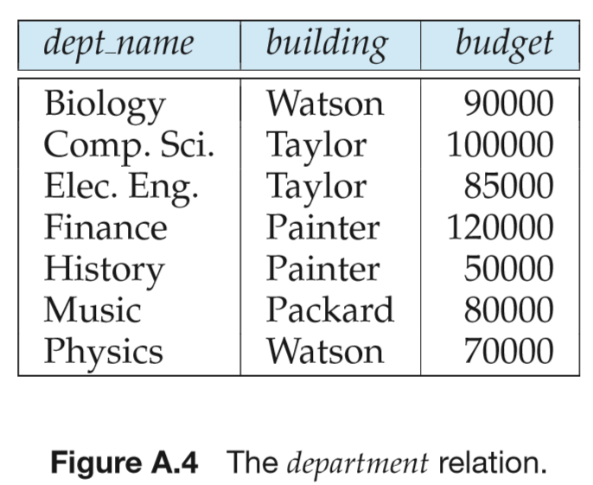
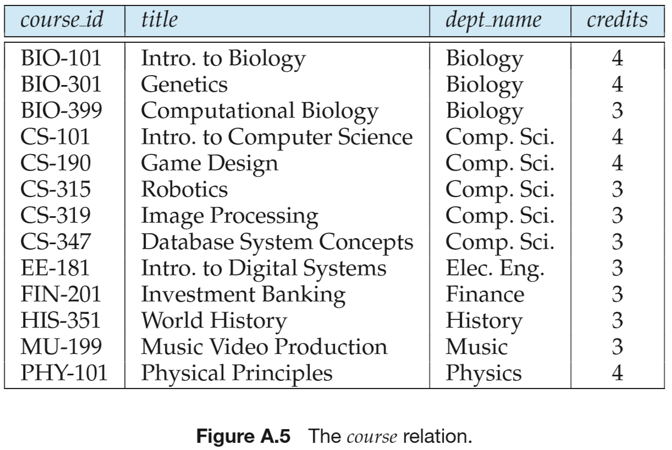
r₁
r₂
return

Slide 47
Referential Integrity (cont.)
referential integrity constraint also called subset dependency since it can be written as ∏_{α} (r₂) ⊆ ∏_{K1} (r₁)
e.g. ∏_{dept_name} (course) ⊆ ∏_{dept_name} (department)
a foreign key α of table r₂ references the primary key attributes K₁ of the referenced table r₁
A good DB design should ensures that any relation schema R₂ (and its any tuples) can only reference other relation schema R₁ through its foreign key

Slide 48
Referential Integrity (cont.)
The primary key, candidate keys and foreign keys can be specified as parts of the SQL create table statement:
the primary key clause lists attributes that comprise the primary key.
the unique key clause lists attributes that comprise a candidate key.
the foreign key clause lists the attributes that comprise the foreign key and the name of the relation referenced by the foreign key.
By default, a foreign key references the primary key attributes of the referenced table.

Slide 49
Cascading Actions in Referential Integrity
create table course ( course_id char(5) primary key, title varchar(20), dept_name varchar(20) references department )
create table course ( … dept_name varchar(20), foreign key (dept_name) references department on delete cascade on update cascade, . . . )
alternative actions to cascade: set null, set default

Slide 50
Cascading Actions in Referential Integrity
The delete/update operations on the referenced relation department will result in the delete/update on the referencing relation course
DBMS
Bio
Bio
r₁
r₂

Slide 51
Integrity Constraint Violation During Transactions
E.g.
create table person ( ID char(10), name char(40), mother char(10), father char(10), primary key ID, foreign key father references person, foreign key mother references person)
How to insert a tuple without causing constraint violation ?
insert father and mother of a person before inserting person
OR, set father and mother to null initially, update after inserting all persons (not possible if father and mother attributes declared to be not null)
OR defer constraint checking (next slide)

Slide 52
实验要求
以openGauss/为平台，定义2张表间的无级联modification、有级联modification的外键关联，
判断：当增/删/改一张表中的主键、外键值时，DBMS的反应

Slide 53
知乎话题: 数据库系统设计时，是否使用外键？！
外键反映了不同数据项间的逻辑关联和约束关系，是一种客观存在
e.g. dept_name in the table department, course
对外键的处理方式反映了对这种数据相互间关系的处理态度，需要根据实际情况而定，考虑数据完整性、处理效率等多种因素
并非简单的“需要外键”，“不设外键”（e.g. 部分MySQL课程、MySQL社区的论点）
方式1：设置数据库表的外键
优点
DBMS自动维护数据间的关联、约束关系
缺点
数据导入、增删改时，多个表间的相互关联，保证了数据一致性、完整性，但影响到整体数据处理效率（额外的DBMS处理开销）
——e.g.插入一条dept_name不存在的course元组，失败，并影响前面已经成功插入的数据——局部错误影响整体

Slide 54
知乎话题: 数据库系统设计时，是否使用外键？！
方式2：不设置外键，由应用程序在业务逻辑层维护数据一致性、完整性
优点
1）避免局部错误影响整体进度；
2）业务逻辑层的数据一致性处理的速度可以比较快，e.g. 将数据提至内存中批量处理
缺点：对应用层业务处理程序设计的额外要求
上述2种方式用在对数据一致性完整性要求高的场景下，e.g. 银行
方式3：不设置外键，业务层应用逻辑也不处理数据间一致性
牺牲数据的正确性，换取数据处理的效率
e.g. 大数据应用场景下，对数据精度、正确性要求不高

Slide 55
LTE网络数据库课程实验: 数据库系统设计时，是否使用外键？
tbMRData、tbATUData表中的主小区、邻小区ID对应于tbCell中的小区标识Sector_ID
实际应用中，不要在tbMRData、tbATUData与tbCell中间建立外键。否则，两表间由于强行的外键约束，可能带来低效的数据处理
E.g. 1 向tbMRData、tbATUData中大批量导入数据时，插入的某条测量报告数据中的某些主小区、邻小区没有出现在tbCell表中，导致本条以及前面各条已成功插入的测量报告均插入失败
E.g.2 当tbCell中某个cell/sector修改名字时，在（非常非常大的, e.g. T级别，上亿条) tbMRData、tbATUData表中以该小区作为主、邻小区的测量报告也必须随之修改
现网环境中， tbMRData、tbATUData的数据与tbCell的数据在主小区、邻小区属性上述经常存在不一致，无法保证外键关联约束，原因：
tbMRData、tbATUData中的测量报告的测量范围超出tbCell表范围，有些测量报告的主小区、邻小区没有出现在tbCell表中
tbCell表中的小区数据有可能被修改，导致与tbMRData、tbATUData中的测量报告不一致

Slide 56
实验要求：TD-LTE网络数据库
在建表、数据导入阶段，先不要建立tbMRData、tbATUData与tbCell间的外键
数据导入完成后，再建立表间外键关联
观察：
是否能建立？
如果建立， tbCell中主键值的变化对tbMRData、tbATUData的影响，或反之
在已经建立的表中增加外键的方法，参见具体DBMS平台用户手册

Slide 57
Complex Check Conditions and Assertions
In the SQL standard, the some construct such as check and assertion are defined to specify the complex integrity constraints.
However, they are not currently supported by most database systems (?)
E.g. For the relation section, the time_slot_id in each tuple should be is actually the identifier of a time_slot in the time_slot relation. This constraint can be defined as
check (time_slot_id in (select time_slot_id from time_slot))
check in create table
create table student ( ID varchar(5), name varchar(20) not null, dept_name varchar(20), tot_cred numeric(3,0), primary key (ID),
foreign key (dept_name) references department)
check(tot_cred>0)
）

Slide 58
Assertions
An assertion is a predicate expressing a condition that we wish the database always to satisfy
e.g. domain constraints, referential-integrity constraint
An assertion in SQL takes the form
create assertion <assertion-name> check <predicate>
also not supported by anyone, e.g. SQL Server等数据库系统似乎不支持创建assertion !!!
Why ？
When an assertion is made, the DBMS tests it for validity. Any modification to DB is allowed only if it does not cause that assertion to be violated
this testing may introduce a significant amount of overhead, hence assertions should be used with great care

Slide 59
Assertion Example
For each tuple in the student relation, the value of the attribute tot_cred must equal the sum of credits of courses that the student has completed successfully
create assertion credits_earned_constraints check
( not exists (select ID
from student
where tot_cred
<> select sum(credits)
from takes natural join course
where student.ID=takes.ID
and grade is not null and grade<>’F’)
)

Slide 60
4.6 Authorization
Forms of authorization on parts of the database include
Read - allows reading, but not modification of data
Insert - allows insertion of new data, but not modification of existing data
Update - allows modification, but not deletion of data Delete - allows deletion of data
Forms of authorization to modify the database schema (covered in Chapter 8)
resources - allows creation of new relations
alteration - allows addition or deletion of attributes in a relation
drop - allows deletion of relations
index

Slide 61
Authorization Specification in SQL
The grant statement is used to confer authorization
grant <privilege list>
on <relation name or view name> to <user list>
<user list> is:
a user-id
public, which allows all valid users the privilege granted
a role (more on this in Chapter 8)
Granting a privilege on a view does not imply granting any privileges on the underlying relations.
The grantor of the privilege must already hold the privilege on the specified item (or be the database administrator)

Slide 62
Privileges in SQL
select: allows read access to relation,or the ability to query using the view
Example: grant users U₁, U₂, and U₃ select authorization on the instructor relation:
grant select on instructor to U₁, U₂, U₃
insert: the ability to insert tuples
update: the ability to update using the SQL update statement
delete: the ability to delete tuples.
all privileges: used as a short form for all the allowable privileges

Slide 63
Revoking Authorization in SQL
The revoke statement is used to revoke authorization.
revoke <privilege list>
on <relation name or view name> from <user list>
Example:
revoke select on branch from U₁； U₂，U₃
<privilege-list> may be all to revoke all privileges the revoker may hold.
If <revokee-list> includes public, all users lose the privilege except those granted it explicitly

Slide 64
Roles
create role instructor;
grant instructor to Amit;
Privileges can be granted to roles:
grant select on takes to instructor;
Roles can be granted to users, as well as to other roles
create role teaching_assistant
grant teaching_assistant to instructor;
Instructor inherits all privileges of teaching_assistant
Chain of roles
create role dean;
grant instructor to dean;
grant dean to Satoshi;

Slide 65
Authorization on Views
create view geo_instructor as (select * from instructor where dept_name = ’Geology’);
grant select on geo_instructor to geo_staff
Suppose that a geo_staff member issues
select * from geo_instructor;
What if
geo_staff does not have permissions on instructor?
creator of view did not have some permissions on instructor?

Slide 66
Other Authorization Features
references privilege to create foreign key
grant reference (dept_name) on department to Mariano;
why is this required?
transfer of privileges
grant select on department to Amit with grant option;
revoke select on department from Amit, Satoshi cascade;
revoke select on department from Amit, Satoshi restrict;
Etc. read Section 4.6 for more details we have omitted here
需结合具体DBMS平台

Slide 67
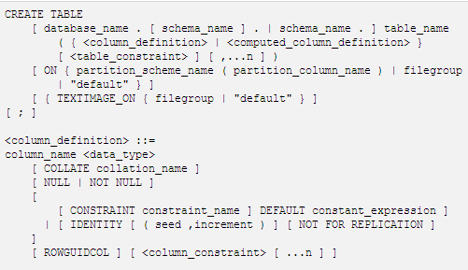
Appendix 4-1 create table in T-SQL
分区
文件组
物理设计

Slide 68
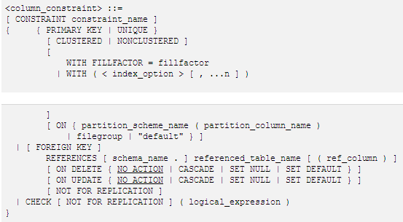
聚集/非聚集索引
（物理设计）
外键

Slide 69
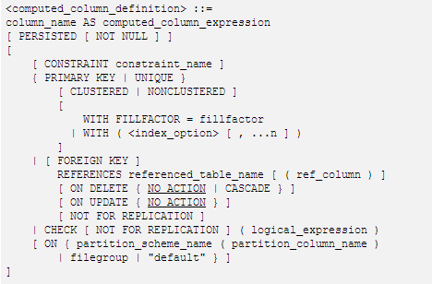
派生属性

Slide 70
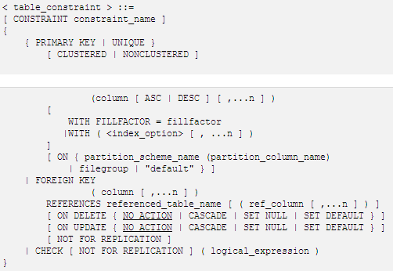

Slide 71
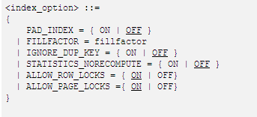
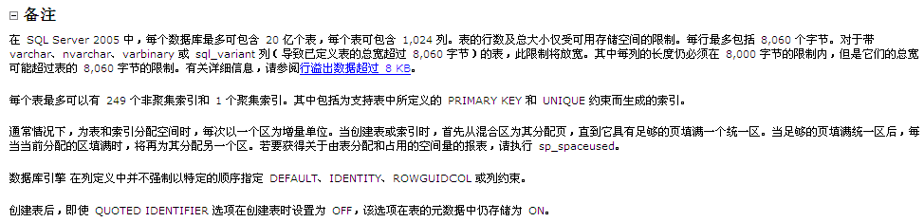
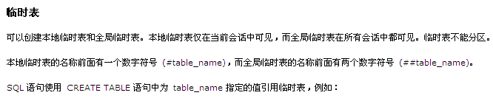

Slide 76

Thanks for your attention

